Slide 1
YOUR ARTAS™ EXPERIENCE
Restore Your Confidence With The ARTAS Hair Restoration Procedure

Slide 2
Causes Of Hair Thinning
Why Is Your Hair Thinning?
95% Of Hair Thinning Is Due To Androgenic Alopecia (Male Pattern Baldness)
Dihydrotestostrerone (DHT) Causes Hair To Become Thin Over Time, Dormant Or Deteriorate
Healthy Hairs Are Resistant To DHT But Can Become Weaker Or Fine Over Time

Slide 3
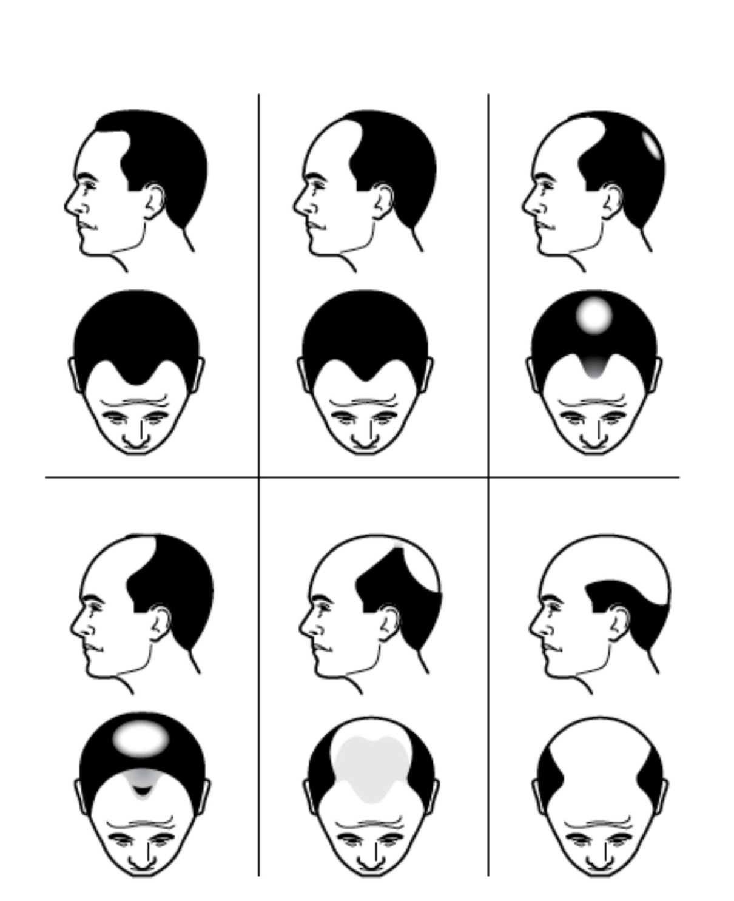
Your Hair Loss
Are You A Candidate For Hair Transplant?
Average Person Sheds Between 50 – 100 Hair Daily
Some Signs Of Hair Loss
– Styling Hair To Cover Thinning Areas
– Wearing A Hat To Cover Bald Spots
Rate Yourself On The Norwood Scale – What Stage Are You Now?
What Can You Expect In The Next Few Years?
– Over Time, Thinning And Balding Progresses
Rate Yourself! Where Are You Now!
I.
II.
III.
IV.
V.
VI.
Norwood Scale

Slide 4
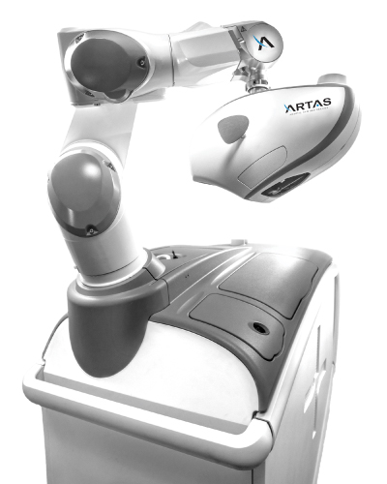
ARTAS Artificial Intelligence (AI)
What Is The ARTAS High-definition Stereoscopic Vision System?
Analyzes, Monitors And Updates Parameters Of Each Follicular Unit 60 Times Per Second
The Human Eye And Brain Can Only Process 10–12 Separate Image Per Second
ARTAS Artificial Intelligence
Detects And Determines Angles, Thickness, And Hair Type
Avoids Damaging Your Existing Healthy (Permanent) Hair

Slide 5
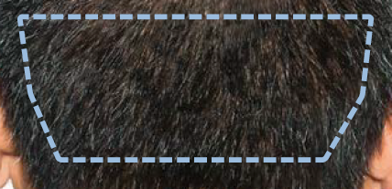
Your Donor Area
What Is Your Donor Area And Why Is It Important?
Area On Your Head Where Hair Is Harvested From
Back And Sides Of Your Head. Not Affected By Hair Loss Causing Hormone DHT
Resistant To DHT And Continues To Grow When Transplanted To Your Balding Areas
Following The ARTAS Robotic Procedure, Your Donor Area Should Be Undetectable, Allowing You To Wear Your Hair In Any Style You Want
Your Donor Area
Before ARTAS
3 Months Post-ARTAS
Photos courtesy of Bernstein Medical Center for Hair Restoration, Robert M. Bernstein, MD

Slide 6
Over-Harvested Donor From Non-ARTAS Techniques
Source: https://www.realself.com/question/donor-area-harvested#
Source: https://www.realself.com/question/austria-hair-transplantation-donor-area-after-month-overharvested-normal-density#media-question-2442673-image-1369615

Slide 7
Donor Area From The ARTAS Procedure
Photos courtesy of Bernstein Medical
Center for Hair Restoration,
Robert M. Bernstein, MD
Photos courtesy of the Hair Sciences
Center of Colorado,
James A. Harris, MD, FACS
Photos courtesy of Bernstein Medical
Center for Hair Restoration,
Robert M. Bernstein, MD

Slide 8
ARTAS Robotic Harvesting
Benefits Of ARTAS Robotic Harvesting
ARTAS Artificial Intelligence
Used To Identify And Select Prime Hair For Harvesting
High-definition Stereoscopic Vision System
Analyzes, Monitors And Tracks Each Hair Sixty Times Per Second
Physician Assisted Robotic Technology
The Thousandth Graft Is The Same Quality As The First Graft. Robots Do Not Get Fatigued
Robotic Precision
Provide Speed, Accuracy And Reproducibility
Fast Recovery
So You Can Get Back To Work And Your Daily Activities Quickly
Other Techniques Cannot Offer
These Technological Advancements
Notes:
Talk Track: Other Hair Transplant
Techniques cannot offer
These highly sophisticated
Technological advancements

Slide 9
The ARTAS Robotic Procedure Protects Your Hair
What About Your Existing Healthy (Permanent) Hair?
Protect The Hair You Already Have And Don’t Risk Losing It During Your Procedure
ARTAS Recipient Site Making
Identifies And Avoids Damaging Existing Healthy (Permanent) Hair In Transplant Area
Identifies Miniaturized Vellus Or Fine, Light Colored Hair In Order To Fill In Thinning Areas
Assists Physician In Placing New Hair By Determining New Sites For Optimal Distribution
Healthy (terminal) Hair – Is thicker, longer and dark (permanent) Miniaturized (vellus) Hair – Is shorter, fine, and light-color (not permanent)

Slide 10
FUT Or Strip Surgery
Potential Complications Can Include Ongoing Pain At The Scar Site And Potential Nerve Damage
Strip Surgery Requires Cutting And Removing A Large Strip Of The Patient’s Scalp
The Wound Is Then Sutured Or Stapled Closed
The Strip Procedure Leaves The Patient With A Large Linear Scar
Patient Demand For Invasive Strip Surgery Is Declining In Favor Of Non-Invasive FUE

Slide 11
ARTAS Recipient Site Making
What Happens To Existing Hair In The Transplant Area?
Physician Uses The ARTAS Hair Studio™ Technology To Build Your Treatment Design
Design Is Transferred To The ARTAS System For Robotic Site Making Pattern
Harvested Hairs Are Implanted Into The Balding Or Thinning Areas Of Your Scalp
Appropriate Placement Of Hair Is Essential For Creating The Best Possible Aesthetic Outcome
Photo courtesy of Berman Skin Institute, David A. Berman, MD

Slide 12
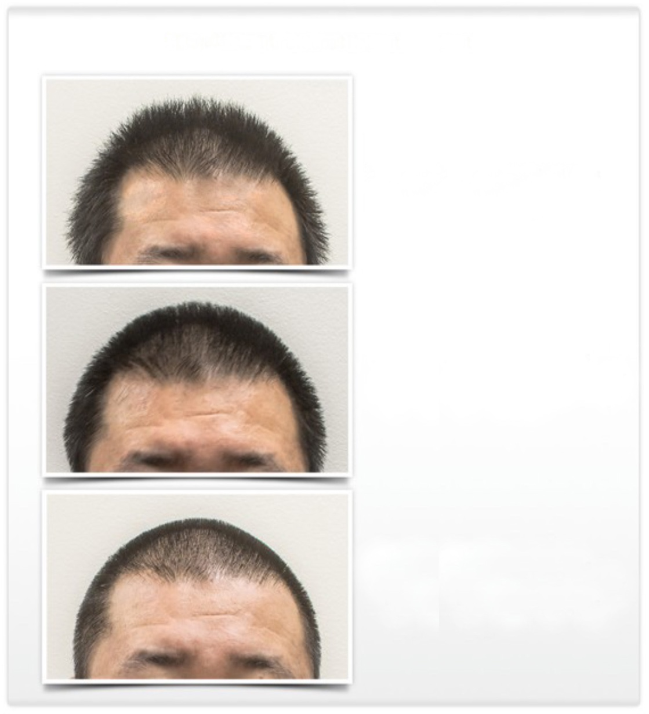
Preparing For Your ARTAS Procedure – Steps For A Transitional Haircut
Do You Need A Haircut Before The Procedure?
Consider A Transitional Haircut A Month Prior To Your ARTAS Robotic Procedure
Your Hair Should Be 1 Millimeter In Length The Day Of Your Procedure
Within 7 - 10 Days After Your ARTAS Robotic Procedure, Your Donor Area Will Be Nearly Undetectable
Steps for Transitional Haircut
1. Start with your original haircut
2. A month prior to your ARTAS Robotic Procedure, shorten your hair length to 3 millimeters
3. 2-3 days prior ARTAS Robotic Procedure, shorten your hair length to 1 millimeters

Slide 13
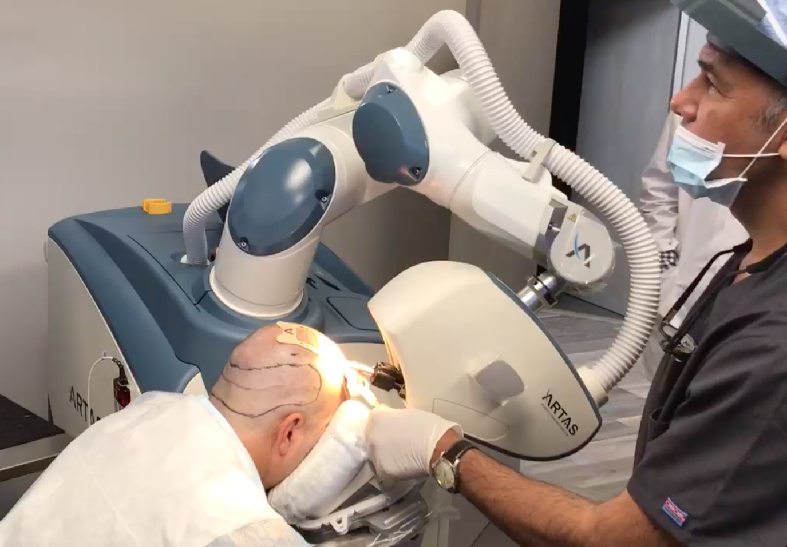
Review Of The ARTAS Procedure – What To Expect
Day Of Your Procedure
Wear Comfortable Clothes
Designate Someone To Drive To And From Your Procedure
Your Physician May Provide Entertainment, Or You May Want To Bring Something From Home
During Your Procedure
Your Physician And ARTAS Team Will Do Everything To Ensure That You Are Comfortable
There Will Be Time For Breaks And Lunch During The Procedure

Slide 14
Review Of The ARTAS Procedure – What To Expect
Immediately Following Your Procedure
You Can Return Home Immediately Following Your Procedure
Your Physician Will Provide You Post-operative Instructions
Most Patients Experience Little Discomfort Following The Procedure, If Pain Does Occur Contact Your Physician

Slide 15
Before And After The ARTAS Procedure
Photos courtesy of the Hair Sciences Center of Colorado, James A. Harris, MD

Slide 16
Before And After The ARTAS Procedure
Photos courtesy of Dr. Yates Hair Science, William D. Yates, MD

Slide 17
Before And After The ARTAS Procedure
Photos courtesy of Dr. Yates Hair Science, William D. Yates, MD
Photos courtesy of New Horizons Center for Cosmetic Surgery, Gregory A. Turowski, MD

Slide 18
Before And After The ARTAS Procedure
Photos courtesy of Dr. Yates Hair Science, William D. Yates, MD

Slide 19
Before And After The ARTAS Procedure
Photos courtesy of Dr. Yates Hair Science, William D. Yates, MD

Slide 20
Before And After The ARTAS Procedure
Photos courtesy of Dr. Yates Hair Science, William D. Yates, MD

Slide 21
The ARTAS™ System from Restoration Robotics is indicated for harvesting hair follicles from the scalp in men diagnosed with androgenetic alopecia (male pattern hair loss) who have black or brown straight hair. The ARTAS System is intended to assist physicians in identifying and extracting hair follicular units from the scalp during hair transplantation. The ARTAS System is also indicated for creating recipient sites for subsequent manual implantation of the harvested follicles. ©2017 Restoration Robotics, Inc. All rights reserved. Restoration Robotics, ARTAS, ARTAS HAIR STUDIO, ARTAS Artificial Intelligence, Confidence Restored and the stylized logos are among the trademarks and/or registered trademarks of Restoration Robotics, Inc. in the United States and other Countries. MK-0865 Rev A (11/17)

